Slide 1
Objects in JavaScript

Slide 2
Objects in JavaScript
Object= Data along with Dynamic aspects
It is a run-time instance of a class.
ClassA
DataElements De1; De2; . .
Methods M1() M2() . .
instanceOf_classA
Objectof_classA
Object has:
All of the behavior defined in the class.
Dynamic aspects of object is in the method

Slide 3
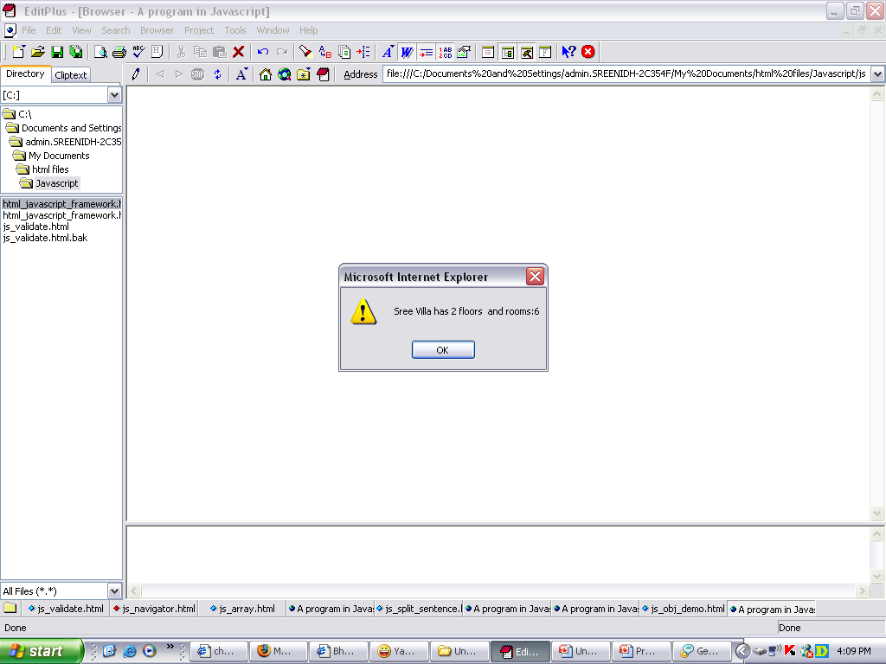
Example of Object
<SCRIPT LANGUAGE="Javascript">
function objDemo()
{ myHouse=new house("Sree Villa", 2, 6);
alert(myHouse.name+" has "+myHouse.floors+"
floors "+" and rooms:"+myHouse.rooms);
}
function house(name, floors, rooms)
{
this.name=name;
this.floors=floors;
this.rooms=rooms;
}
</SCRIPT> </HEAD>
<BODY onLoad=“objDemo()"> </BODY>

Slide 4
Keywords
NEW: TO CREATE AN INSTANCE OF A CLASS
THIS : USED TO DIFFERENTIATE BETWEEN GLOBAL VARIABLES AND WHICH ARE PART OF OBJECT, BUT HAVE THE SAME.
.(DOT): ACCESS THE METHODS OF THE OBJECT

Slide 5
Exception Handling
Used to handle the exceptions.
Syntax:
try{
    Statement1;
    Statement2;
    ..
    ..
}catch exception{
    ..
    ..
}

Slide 6
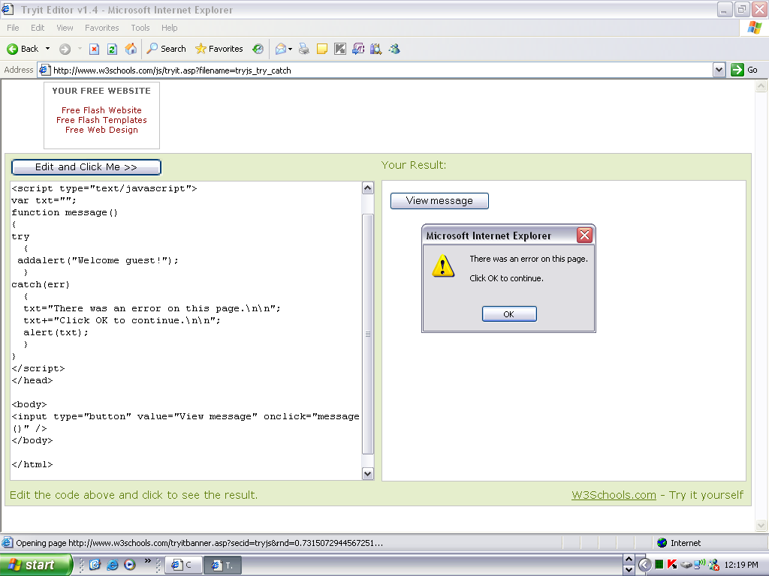
Example for Exception handling
<script type="text/javascript">
var txt="";
function message()
{
try
{addalert("Welcome guest!");}
catch(err)
{
txt="There was an error on this page.\n\n”
txt+="Click OK to continue.\n\n";
alert(txt);
}
}
</script>
<body>
<input type="button" value="View message" onclick="message()" />
</body>

Slide 7
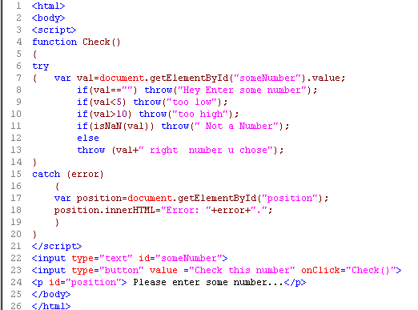
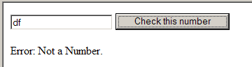

Slide 8
Regular Expressions
One way to find the string pattern:
var pattern=“target”;
var string=“can you find the target”;
string.match(pattern);
Regular Expression: describes a set of characters that may be present in a string.
RegExp is a JavaScript object.
Ways to create regular expressions:
Static way:
var regex = /fish|fowl/;
Dynamic way:
var regex = new RegExp (“ fish|fowl ” );
Other way to find the string pattern:
var pattern=new RegExp(“target”);
var string=“can you find the target”;
pattern.exec(string);

Slide 9
RegExp Object Methods
Method | Description
test(str) | Search a str for a specified value. Returns true or false
compile() | Change the regular expression
exec(str) | Returns the found value and remembers the position in the str

Slide 10
Examples for test and compile
1. var patt1=new RegExp("e");
document.write(patt1.test("The best things in life are free"));
OUTPUT: true
2. var patt1=new RegExp("e");
document.write(patt1.test("The best things in life are free"));
patt1.compile("d");
document.write(patt1.test("The best things in life are free"));
  OUTPUT: truefalse
Since there is an "e" in the string, but not a "d", the output of the code above will be:

Slide 11
RegExp flags
Modifier | Description
i | Perform case-insensitive matching
g | Perform a global match. Find all matches (do not stop after the first match)
gi | Perform a global case-insensitive match. Find all matches (do not stop after the first match)
m | Perform multiline matching

Slide 12
Example using RegExp class and exec method and flag
var re=new RegExp("[F|f]red","g");
var msg="Have you met Fred today fred?";
var results=re.exec(msg);
while(results!=null)
{
alert("I found "+results[0]);
results=re.exec(msg);
}
Output in 2 alert boxes:
I found Fred
I found fred

Slide 13
RegExp Grammar- Position
Modifier | Description | Example | Output
^ | Get a match at the beginning of a string | var patt = new RegExp(“^is"); patt.exec(“is it all?”); | is
$ | Get a match at the end of a string | var patt = new RegExp("is$"); patt.exec(“There it is”); | is
\b | Word boundary. Get a match at the beginning or end of a word in the string | var str = "Visit W3Schools"; var patt1 = /\bW3/; patt1.exec(str); var patt1=/ls\b/; | W3 ls
\B | Non-word boundary. Get a match when it is not at the beginning or end of a word in the string | var str = "Visit W3Schools"; var patt1 = /\Bis/; patt1.exec(str); | is
?= | A positive look ahead. Get a match if a string is followed by a specific string | var str = "Is this all there is“ var patt1 = new RegExp("is(?= all)"); patt1.exec(str); | is
?! | A negative look ahead. Get a match if a string is not followed by a specific string | var str = "Is this all there is"; var patt1 = new RegExp("is(?!all)","gi"); | Is this all there is

Slide 14
RegExp Modifiers - Literals
Modifier | Description
[xyz] | Find any character in the specified character set
[^xyz] | Find any character not in the specified character set
. (dot) | Find any character except newline or line terminator
\w | Find any alphanumeric character including the underscore
\W | Find any non-word character
\d | Find any single digit
\D | Match anything except for digits
a|b | Match a or b

Slide 15
String Object Methods that supports Regular Expressions
Method | Description
search(value) | Search a string for a specified value. Returns the position of the value
match(value) | Search a string for a specified value. Returns an array of the found value(s)
replace(pattern1, pattern2) | Replace characters with other characters
split(pattern ) | Split a string into an array of strings based upon pattern

Slide 16
RegExp Examples
RegEx | Description
^ | The password string will start this way
(?=.*[a-z]) | The string must contain at least 1 lowercase alphabetical character
(?=.*[A-Z]) | The string must contain at least 1 uppercase alphabetical character
(?=.*[0-9]) | The string must contain at least 1 numeric character
(?=.[!@#\$%\^&]) | The string must contain at least one special character, but we are escaping reserved RegEx characters to avoid conflict
(?=.{8,}) | The string must be eight characters or longer

Slide 17
Password Conditions at least one lower case letter at least one upper case letter at least one digit at least one underscore or non-word character
^(?=.*[a-z])(?=.*[A-Z])(?=.*\d)(?=.*(_|[^\w])).+$
A short explanation:
^ :- the start of the string
(?=.*[a-z]) :- use positive look ahead to see if at least one lower case letter exists
(?=.*[A-Z]) :- use positive look ahead to see if at least one upper case letter exists
(?=.*\d) :- use positive look ahead to see if at least one digit exists
(?=.*[_\W]) :- use positive look ahead to see if at least one underscore or non-word character exists .
+ :- gobble up the entire string
$ :- the end of the string

Slide 18
Dynamic HTML:
Event Model
1 Introduction
2 Event ONCLICK
3 Event ONLOAD
4 Error Handling with ONERROR
5 Tracking the Mouse with Event ONMOUSEMOVE
6 Rollovers with ONMOUSEOVER and ONMOUSEOUT
7 Form Processing with ONFOCUS and ONBLUR
More Form Processing with ONSUBMIT and ONRESET
Key board events
Event Bubbling

Slide 19
INTRODUITON
JavaScript is an event-driven system. Nothing is activated unless triggered from outside the script via browser.
  A mouse click
  A web page or an image loading
  Moving mouse over a hot spot on the web page
  Selecting an input field in an HTML form
  Submitting an HTML form
  A keystroke

Slide 20
JavaScript Handlers
Event | Triggered when
onLoad and onUnload | user enters or leaves the page.
onBlur | Input focus is moved from the object of a form
onChange | Value of field is changed by user entering or deleting the data
onFocus | Input focus is given to an element. reverse of onBlur
OnClick | Mouse is clicked over an element of a page
onDblClick | Form element or link is double clicked.
onDragDrop | System file is dragged with a mouse and dropped onto the browser
onKeyUp, onKeyDown, onKeyPress | Key is released, key is depressed but not released, Key is pressed

Slide 21
JavaScript Handlers(contd.)
Event | Triggered when
onMouseDown, onMouseUp, onMouseOut, onMouseOver | Mouse button is pressed Mouse button is released Mouse pointer moves off an element Mouse pointer is moved over an element
onResize | Window is resized by the user
onSelect | field on a form is selected either by mouse or by tabbing
onSubmit | Submit button is pressed
Syntax:
<element attributes event=“handler”>
  Handler : javascript function defined.

Slide 22
JS objects and Event Handlers
Object | Event Handlers
window | onLoad, onUnload, onBlur, onFocus,
link | onClick, onMouseOut, onMouseOver,
area | onMouseOut, onMouseOver
image | onAbort, onError, onLoad
form | onReset, onSubmit,
text, textarea, password | onBlur, onChange, onFocus, onSelect
Button, reset, submit, radio, checkbox | onClick
Select | onBlur,, onChange, onFocus
Fileupload | onBlur,, onSelect, onFocus

Slide 23
Event Examples

Slide 24
Event ONCLICK AND ONLOAD
ONCLICK event
  Fires when user clicks mouse on a specific item
ONLOAD event
  Fires when element finishes loading successfully
  Often used in BODY tag
    Initiate scripts as soon as page loads

Slide 25
Error Handling with ONERROR
ONERROR event
  Error dialog box presented by browsers is usually confusing to user
  Use ONERROR event to restrain dialog box and handle errors elegantly
  One of few events that pass parameters
    Three parameters:
      Type of error
      URL of file with error
      Line number of error
  Use to prevent incompatible browsers from complaining about scripts they cannot process

Slide 26
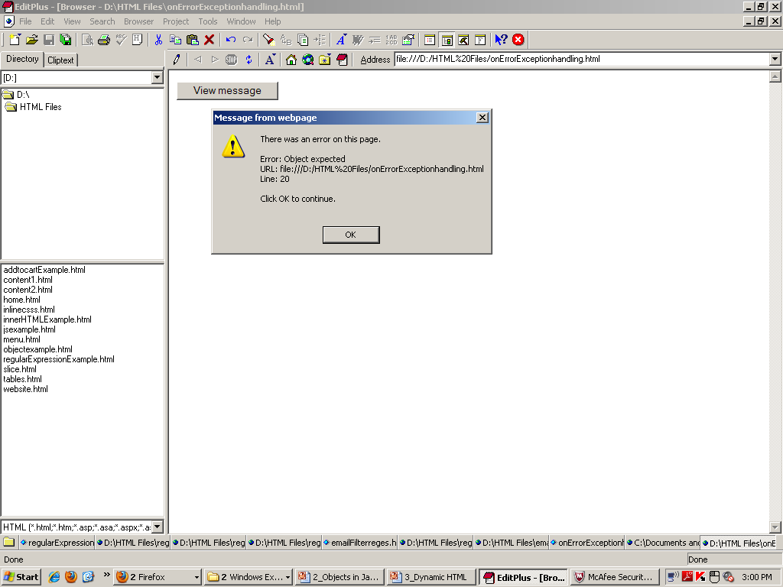
<html> <head>
<script>
onerror=handleError;
var txt="";
function handleError(msg,url,l)
{
txt="There was an error on
this page.\n\n";
txt+="Error: " + msg + "\n";
txt+="URL: " + url + "\n";
txt+="Line: " + l + "\n\n";
txt+="Click OK to
continue.\n\n";
alert(txt);
return true;
}
function message()
{ adddlert("Welcome guest!"); }
</script> </head> <body>
<input type="button" value="View message" onclick="message()" />
</body> </html>
Output

Slide 27
5 Tracking the Mouse with Event ONMOUSEMOVE
  Fires constantly whenever mouse is in motion
  Contains info about triggered event:
    srcElement: Pointer to element object that triggered event
    offsetX and offsetY: Give location of mouse cursor relative to top-left corner of object in which event triggered
    pageX and pageY: Relative to the top left of the fully rendered content area in the browser.
    screenX and screenY: Relative to the top left of the physical screen/monitor.
clientX and clientY:: Relative to the upper left edge of the content area (the viewport) of the browser window.

Slide 28
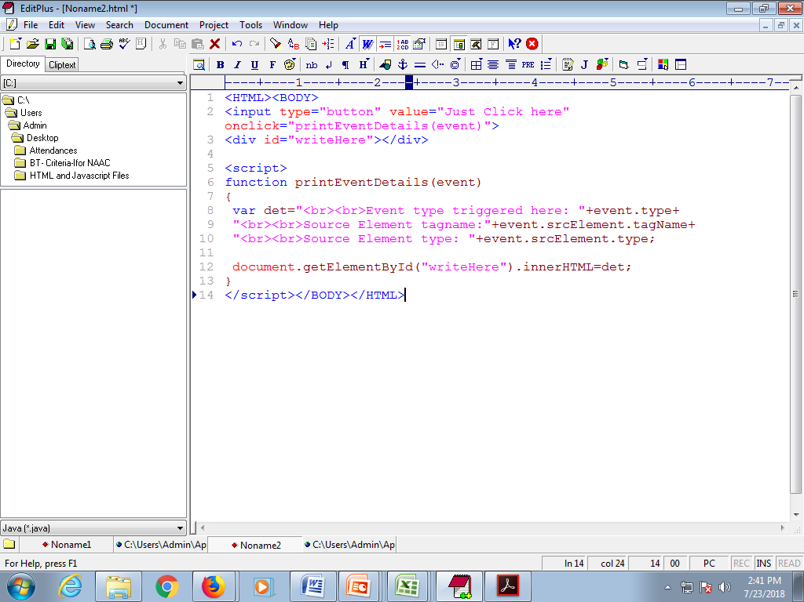
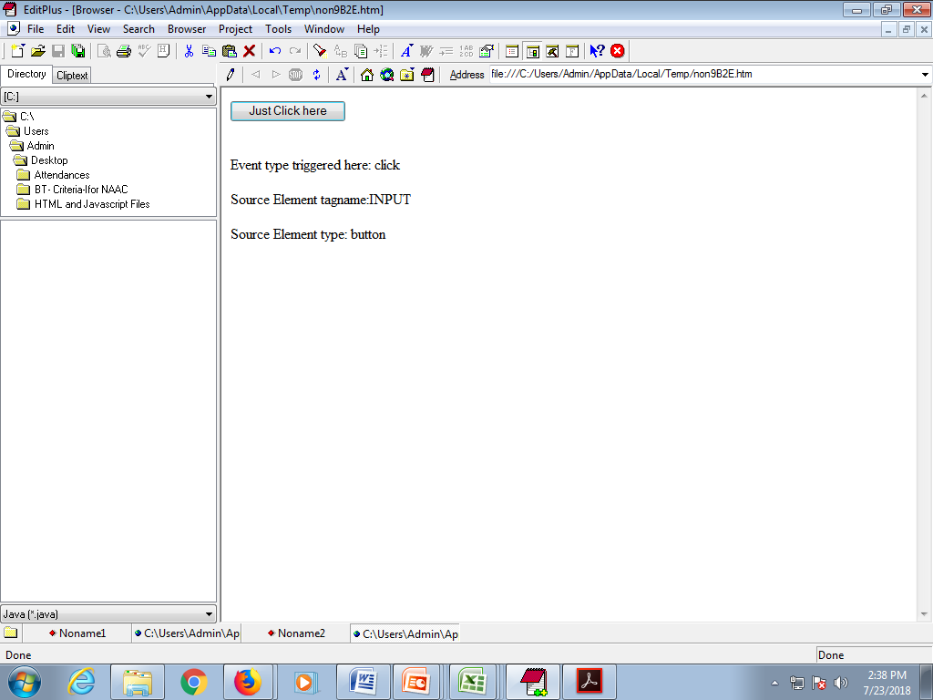
Example to display event details (output shown in the box)

Slide 29
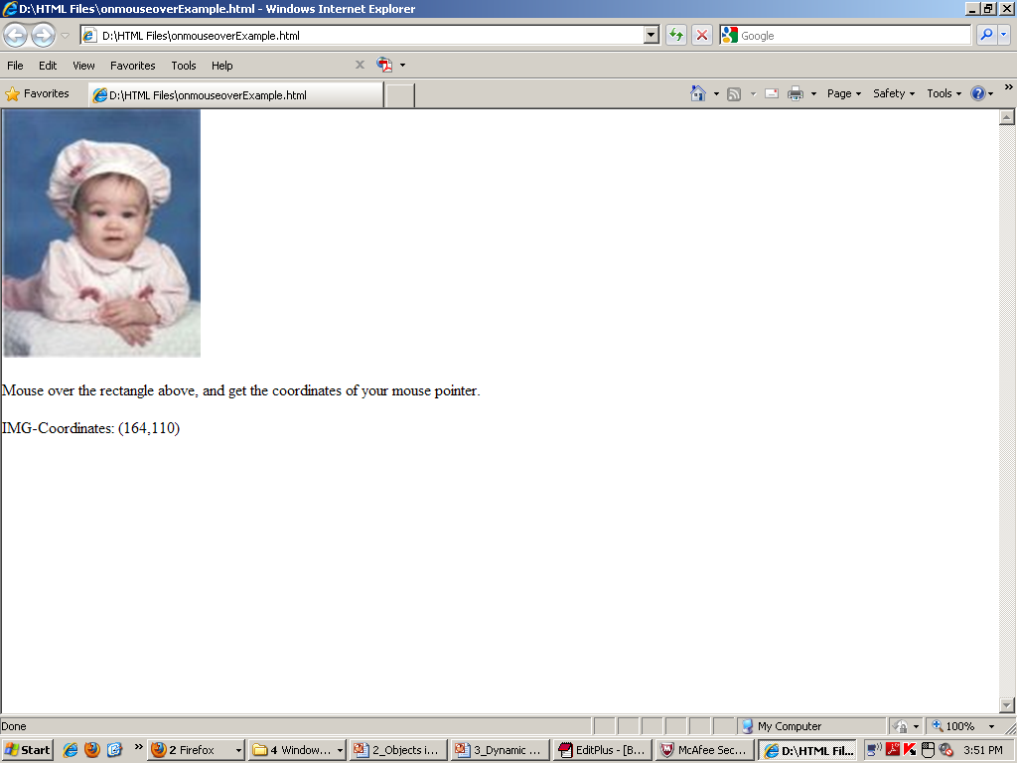
Ex: Tracking the coordinates when mouse is moving
with Event ONMOUSEMOVE

Slide 30
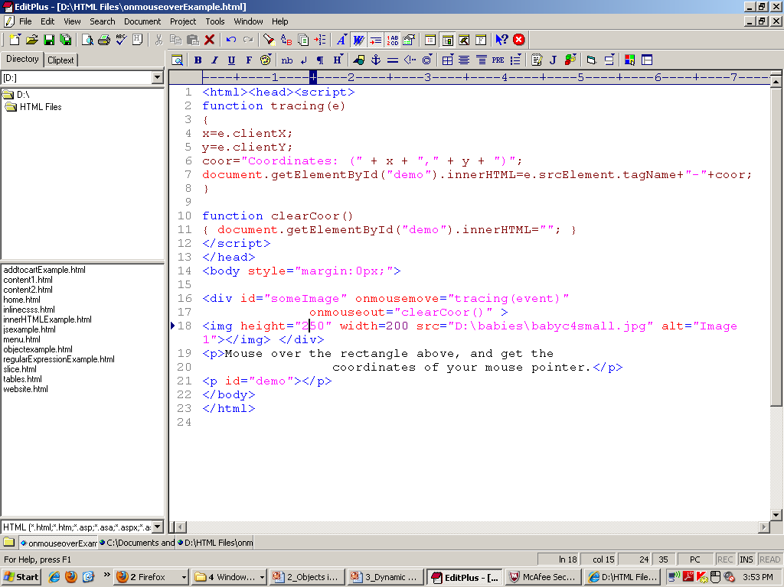

Slide 31
Rollovers with ONMOUSEOVER and ONMOUSEOUT
ONMOUSEOVER event
  Fires when mouse cursor moves over an element
ONMOUSEOUT event
  Fires when mouse cursor leaves the element
Combine events for rollover effect
  Pre-load images

Slide 32
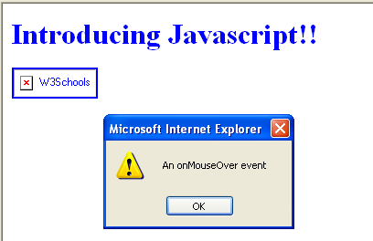
Example for onMouseOver
<BODY>
<H1 style='COLOR:blue'>Introducing Javascript!!</H1>
<a href="http://www.w3schools.com"
onmouseover="alert('An onMouseOver event'); ">
<img src="w3s.gif" alt="W3Schools" />
</a>
</BODY>

Slide 33
7 Form Processing with ONFOCUS and ONBLUR
ONFOCUS event
  Fires when an element gains focus
    User clicks on form field
    User uses Tab key to highlight element
ONBLUR event
  Fires when an element loses focus

Slide 34
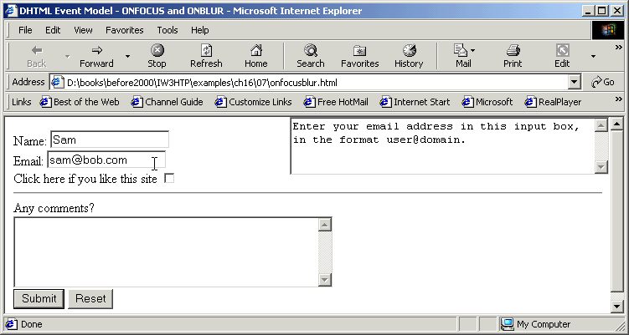
Example for ONFOCUS and ONBLUR

Slide 35
1 <!DOCTYPE html PUBLIC "-//W3C//DTD HTML 4.0 Transitional//EN">
2 <HTML>
3
4 <!-- Fig 16.7: onfocusblur.html -->
5 <!-- Demonstrating the ONFOCUS and ONBLUR events -->
6
7 <HEAD>
8 <TITLE>DHTML Event Model - ONFOCUS and ONBLUR</TITLE>
9 <SCRIPT LANGUAGE = "JavaScript">
10
11 var helpArray =
12 [ "Enter your name in this input box.",
0
13 "Enter your email address in this input box, " +
1
14 "in the format user@domain.",
15 "Check this box if you liked our site.",
2
16 "In this box, enter any comments you would " +
3
17 "like us to read.",
4
18 "This button submits the form to the " +
19 "server-side script",
20 "This button clears the form",
5
21 "This TEXTAREA provides context-sensitive " +
6
22 "help. Click on any input field or use the TAB " +
23 "key to get more information about the input field." ];
24
25 function helpText( messageNum )
26 {
27 myForm.helpBox.value = helpArray[ messageNum ];
28 }
29 </SCRIPT>
30 </HEAD>
31
32 <BODY>

Slide 36
33
34<FORM ID = "myForm">
35Name: <INPUT TYPE = "text" NAME = "name"
36 ONFOCUS = "helpText(0)" ONBLUR = "helpText(6)"><BR>
37Email: <INPUT TYPE = "text" NAME = "email"
38 ONFOCUS = "helpText(1)" ONBLUR = "helpText(6)"><BR>
39Click here if you like this site
40<INPUT TYPE = "checkbox" NAME = "like" ONFOCUS = "helpText(2)"
41 ONBLUR = "helpText(6)"><BR><HR>
42
43Any comments?<BR>
44<TEXTAREA NAME = "comments" ROWS = 5 COLS = 45 ONFOCUS =
45 "helpText(3)" ONBLUR = "helpText(6)"></TEXTAREA><BR>
46<INPUT TYPE = "submit" VALUE = "Submit" ONFOCUS = "helpText(4)"
47 ONBLUR = "helpText(6)">
48<INPUT TYPE = "reset" VALUE = "Reset" ONFOCUS = "helpText(5)"
49 ONBLUR = "helpText(6)">
50
51<TEXTAREA NAME = "helpBox" STYLE = "position: absolute;
52 right: 0; top: 0" ROWS = 4 COLS = 45>
53This TEXTAREA provides context-sensitive help. Click on any
54input field or use the TAB key to get more information about the
55input field.</TEXTAREA>
56</FORM>
57
58</BODY>
59</HTML>

Slide 37
8 More Form Processing with ONSUBMIT and ONRESET
ONSUBMIT event
  Fires when a form is submitted
ONRESET event
  Fires when a form is reset

Slide 38
4 <!-- Fig 16.8: onsubmitreset.html -->
5 <!-- Demonstrating the ONSUBMIT and ONRESET events -->
7 <HEAD>
8 <TITLE>DHTML Event Model - ONSUBMIT and ONRESET events</TITLE>
9 <SCRIPT LANGUAGE = "JavaScript">
11 var helpArray =
12 [ "Enter your name in this input box.",
13 "Enter your email address in this input box, " +
14 "in the format user@domain.",
15 "Check this box if you liked our site.",
16 "In this box, enter any comments you would " +
17 "like us to read.",
18 "This button submits the form to the " +
19 "server-side script",
20 "This button clears the form",
21 "This TEXTAREA provides context-sensitive " +
22 "help. Click on any input field or use the TAB " +
23 "key to get more information about the input field." ];
25 function helpText( messageNum )
26 {
27 myForm.helpBox.value = helpArray[ messageNum ];
28 }
30 function formSubmit() {
31 window.event.returnValue = false;

Slide 39
33 if ( confirm ( "Are you sure you want to submit?" ) )
34 window.event.returnValue = true;
35 }
36
37 function formReset() {
38 window.event.returnValue = false;
39
40 if ( confirm ( "Are you sure you want to reset?" ) )
41 window.event.returnValue = true;
42 }
44</SCRIPT>
45</HEAD>
47<BODY>
49<FORM ID = "myForm" ONSUBMIT = "formSubmit()"
50 ONRESET = "formReset()">
51Name: <INPUT TYPE = "text" NAME = "name" ONFOCUS = "helpText(0)"
52 ONBLUR = "helpText(6)"><BR>
53Email: <INPUT TYPE = "text" NAME = "email"
54 ONFOCUS = "helpText(1)" ONBLUR = "helpText(6)"><BR>
55Click here if you like this site
56<INPUT TYPE = "checkbox" NAME = "like" ONFOCUS = "helpText(2)"
57 ONBLUR = "helpText(6)"><HR>
58
59Any comments?<BR>
60<TEXTAREA NAME = "comments" ROWS = 5 COLS = 45
61 ONFOCUS = "helpText(3)" ONBLUR = "helpText(6)"></TEXTAREA><BR>
62<INPUT TYPE = "submit" VALUE = "Submit" ONFOCUS = "helpText(4)"
63 ONBLUR = "helpText(6)">
64<INPUT TYPE = "reset" VALUE ="Reset" ONFOCUS = "helpText(5)"

Slide 40
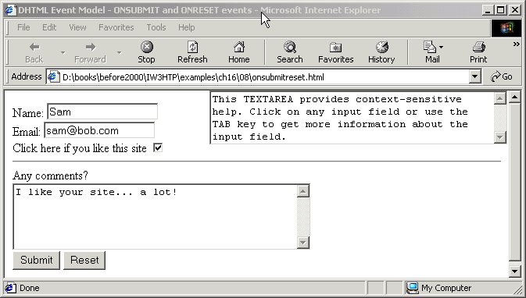
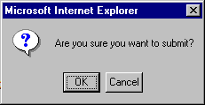
65 ONBLUR = "helpText(6)">
67<TEXTAREA NAME = "helpBox" STYLE = "position: absolute; right:0;
68 top: 0" ROWS = 4 COLS = 45>
69This TEXTAREA provides context-sensitive help. Click on any
70input field or use the TAB key to get more information about the
71input field.</TEXTAREA>
72</FORM>

Slide 41
Key board events
onkeyup
    --Raises when key is up
onkeydown
raises when key is down
3. onkeypress
    --raises when key is pressed
4. onhelp
raises whenever f1 key is pressed.

Slide 42
10 Event Bubbling
Event bubbling
  Events fired in child elements also “bubble” up to their parent elements for handling
  Cancel bubbling using cancelBubble property of event object
  Forgetting to cancel event bubbling when necessary may cause unexpected results in your scripts

Slide 43
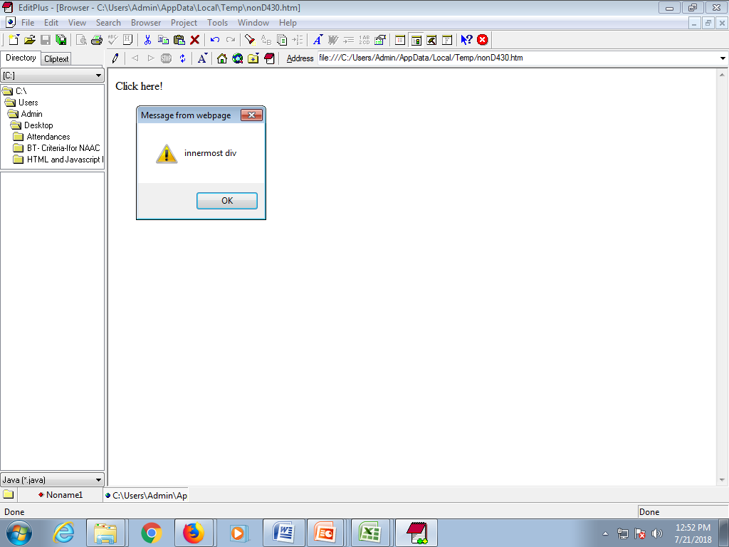
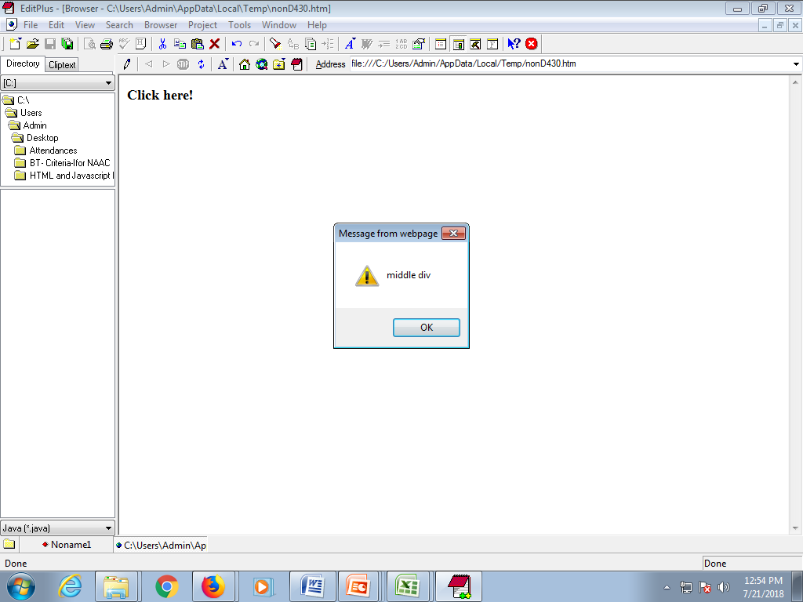

Event Bubbling Example
1st popup
<HTML>
<BODY>
<div onClick="alert('outer div')">
<div onClick="alert('middle div')">
<div onClick="alert('innermost div')">
Click here!
</div>
</div>
</div>
</BODY>
</HTML>
2nd popup
3rd popup

Slide 44
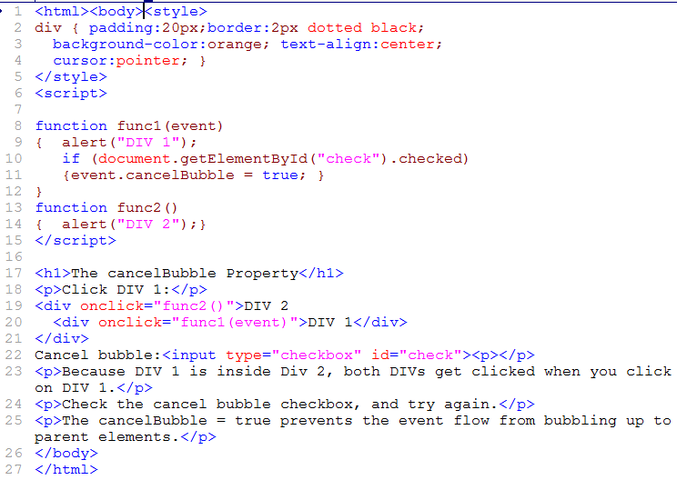
Event Bubbling propagation cancelling example

Slide 45
Event Bubbling propagation cancelling example (code)
<html><body><style>
div { padding:20px;border:2px
dotted black;
background-color:orange;
text-align:center;
cursor:pointer; }
</style><script>
function func1(event)
{ alert("DIV 1");
if(document.getElementById("check").checked)
{
}}
function func2()
{ alert("DIV 2");}
</script>
<h1>The cancelBubble Property</h1>
<p>Click DIV 1:</p>
<div onclick="func2()">DIV 2
<div onclick="func1(event)">DIV 1</div>
</div>
Cancel bubble:<input type="checkbox" id="check"><p></p>
<p>Because DIV 1 is inside Div 2, both DIVs get clicked when you click on DIV 1.</p>
<p>Check the cancel bubble checkbox, and try again.</p>
<p>The cancelBubble = true prevents the event flow from bubbling up to parent elements.</p>
</body>
</html>

Slide 46
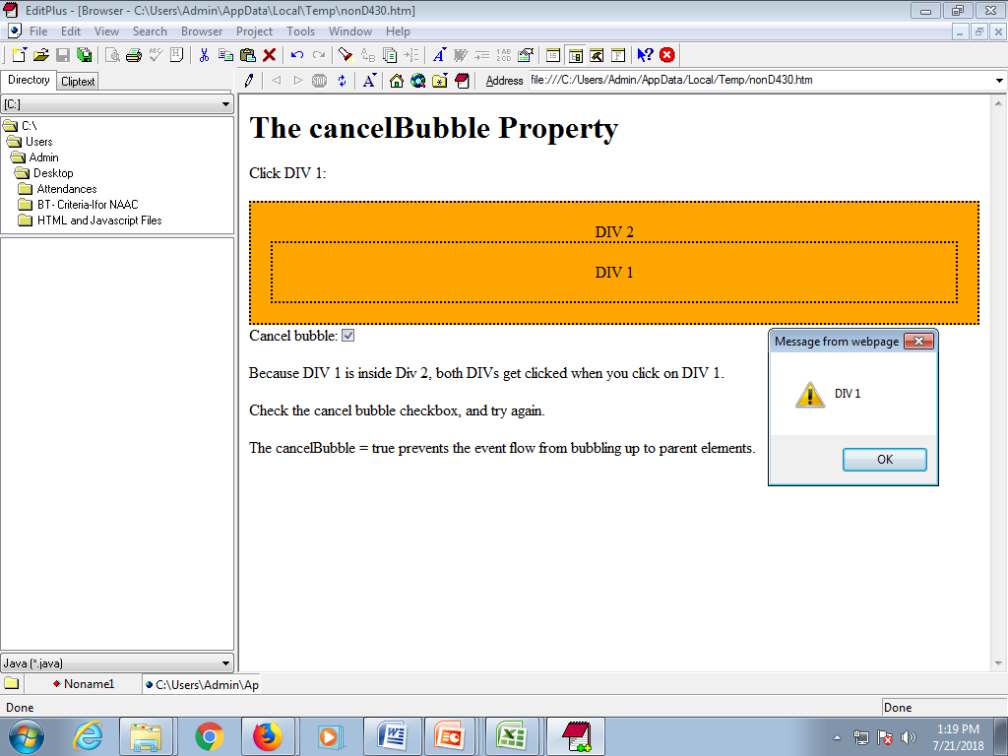
Example Output

Slide 47
Built-in JavaScript Objects
Object | What is it? | Properties | Methods
document | Webpage being displayed or created | bgcolor, fgcolor, anchors[], links[], layers[] | write(), writeln() , close()
window | Mutable object addressed by javascript code | toolbar=[0|1], location=[0|1], directories=[0|1], status=[0|1], menubar=[0|1],scrollbars=[0|1],resizable=[0|1] | open(“url”,”name”), close(), Scroll(coord,coord)
form | User interactive objects; can be held in an array as elements[] | onClick=“method” onSubmit=“method” | reset()
browser | Its also called navigator object | appCodeName, appName, userAgent, plugins, mimetypes

